Slide 1


Remote Databases
HTTP, RESTful Web Services, HTTP and REST Tools: Postman, Fiddler
SoftUni Team
Technical Trainers
Software University
http://softuni.bg

Slide 2
Table of Contents
Firebase
Using Firebase BaaS
Kinvey
Using Kinvey mBaaS

Slide 3
Have a Question?
sli.do #JS-CORE

Slide 4
Firebase
Real-Time Cloud DB and App Platform by Google

Slide 5
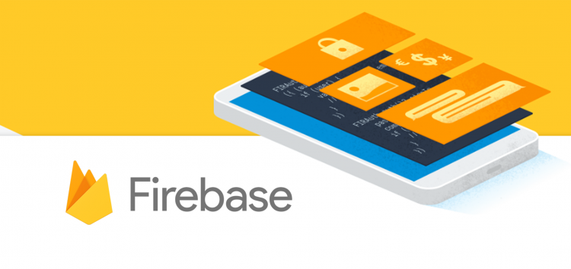
Firebase
Mobile and web development platform. It provides:
Realtime database
Backend as a service
JSON-based data structure

Slide 6
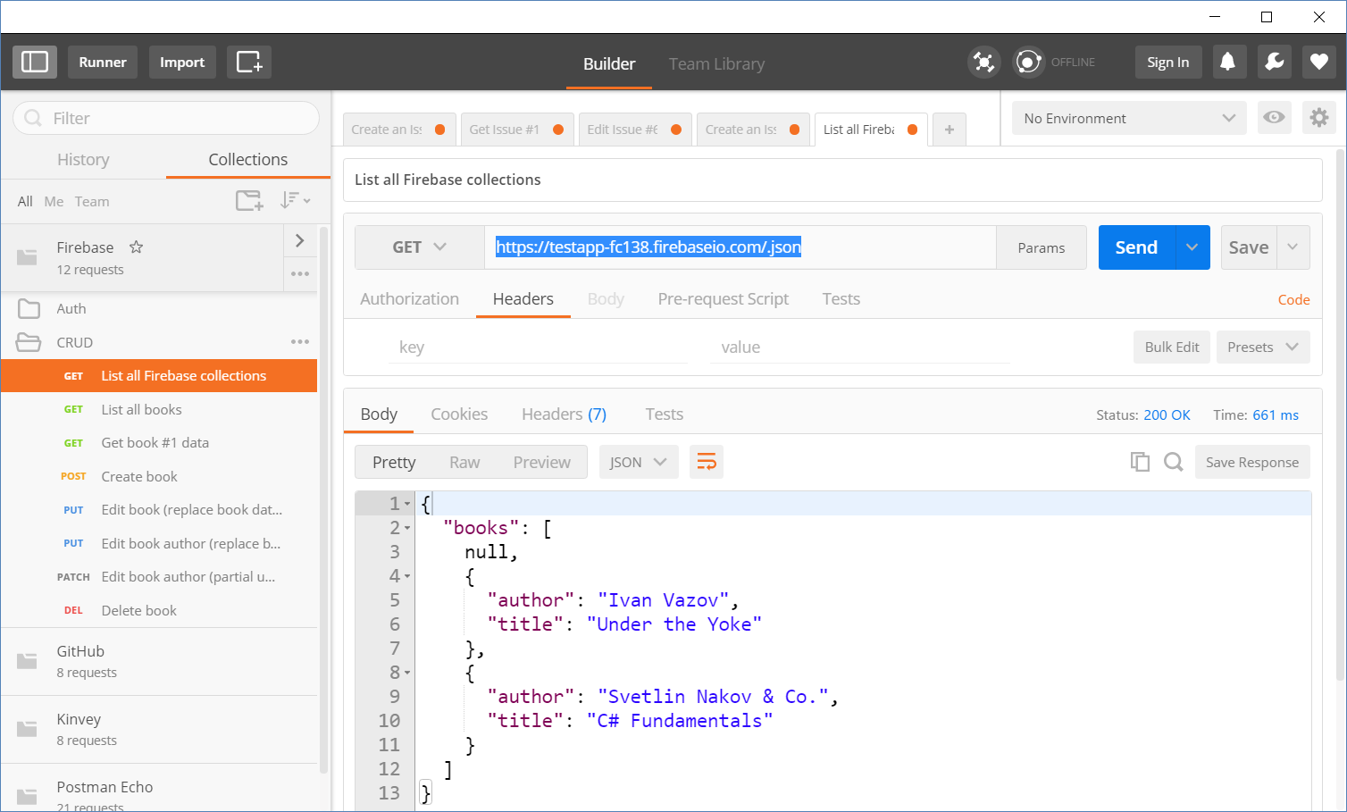
Accessing Firebase REST API with Postman
Append .json to your DB object URL

Slide 7
Firebase Demo

Slide 8
Firebase REST API - CRUD Operations
GET
https://testapp-fc138.firebaseio.com/.json
GET
https://testapp-fc138.firebaseio.com/books.json
GET
https://testapp-fc138.firebaseio.com/books/1.json
GET
https://testapp-fc138.firebaseio.com/books/1/author.json
POST
https://testapp-fc138.firebaseio.com/books.json
Body
{"title":"New title", "author":"New author"}
DELETE
https://testapp-fc138.firebaseio.com/books/6.json

Slide 9
Firebase REST API - CRUD Operations (2)
PUT
https://testapp-fc138.firebaseio.com/books/7.json
Body
{"title":"Edited", "year":1980, "ISBN":"954X"}
PATCH
https://testapp-fc138.firebaseio.com/books/7.json
Body
{"year":1981, "author":"Author Changed"}
PUT
https://testapp-fc138.firebaseio.com/books/7/author.json
Body
"New author was assigned"
DELETE
https://testapp-fc138.firebaseio.com/books/7/author.json

Slide 10
Authentication vs. Authorization
Authentication
The process of verifying the identity of a user or computer
Questions: "Who are you?", "How you prove it? "
Credentials can be password, smart card, external token, etc.
Authorization
The process of determining what a user is permitted to do on a computer or network
Questions: " What are you allowed to do?", "Can you see this page?"

Slide 11
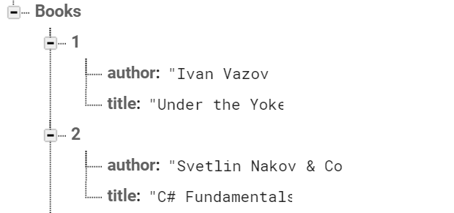

Firebase and Postman: All books
Open Firebase and create "TestApp" project
Create the following structure
Get all books by AJAX request

Slide 12
Firebase and Postman: Get Book
Using the recently created project in Firebase
Get the book with id: 1
Don't forget the .json extension at the end

Slide 13
Firebase and Postman: Create Book
To create a book in our Firebase project
Send a "POST" request
JSON body should be in the following format:
{
"title":"New title",
"author":"New author"
}

Slide 14

Kinvey
Collection-Based Cloud DB (mBaaS)

Slide 15


Kinvey as Back-End
Mobile Back-End as a Service (mBaaS)
Holds your app / mobile app data in the cloud
Hold users and user data
Users (API for creating an account)
Data collections (API for CRUD operations)
Files (upload / download / delete)

Slide 16
Kinvey Demo

Slide 17
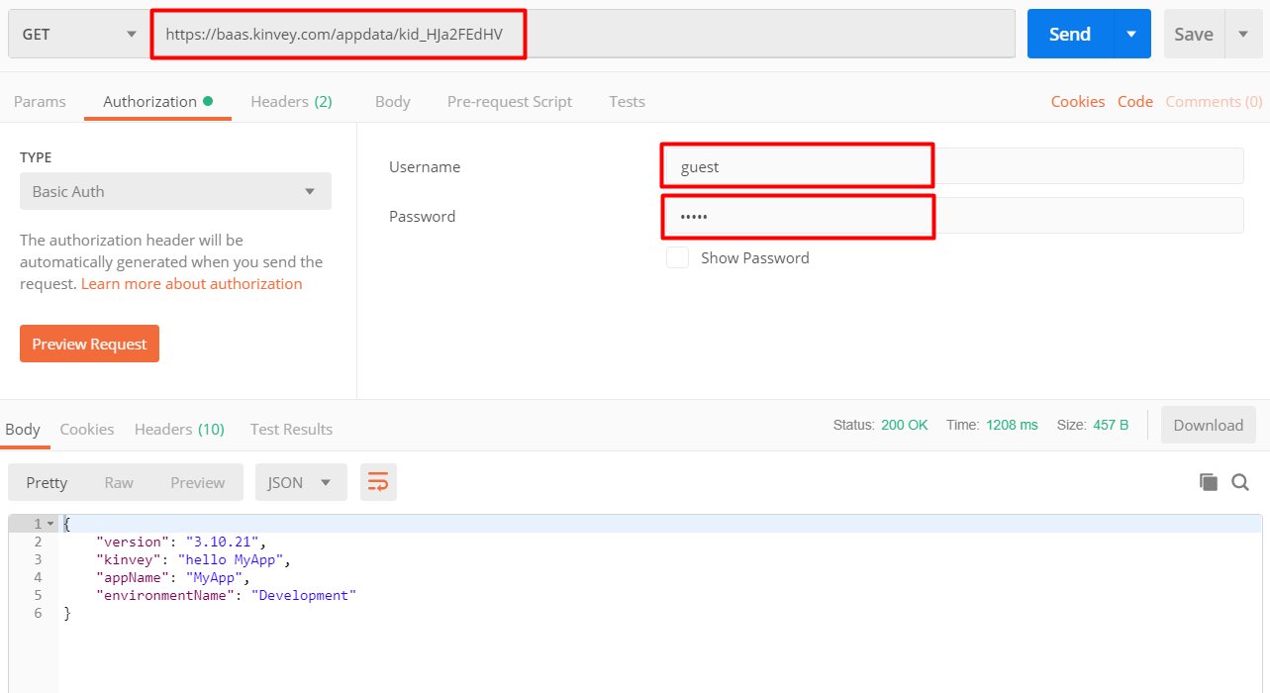
Test Your Backend with Postman
https://baas.kinvey.com/appdata/{app_id}
Basic authentication user: guest
pass: guest

Slide 18
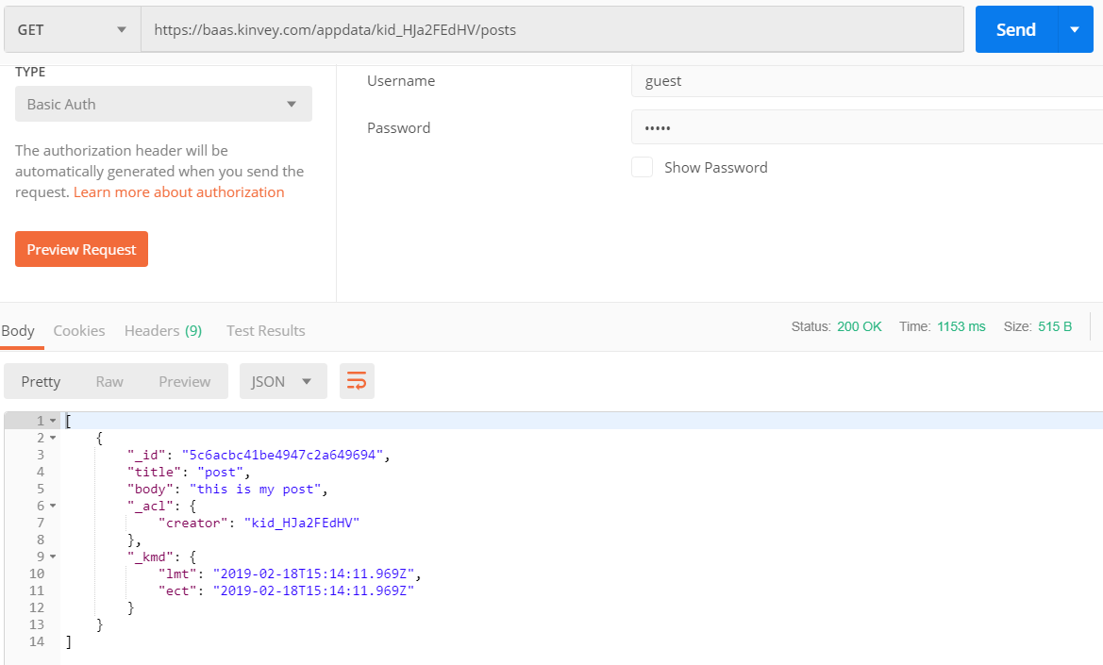
Kinvey and Postman: List All Posts
URL: https://baas.kinvey.com/appdata/{app_id}/posts
Method: GET
Authentication: Basic
User: guest
Pass: guest

Slide 19
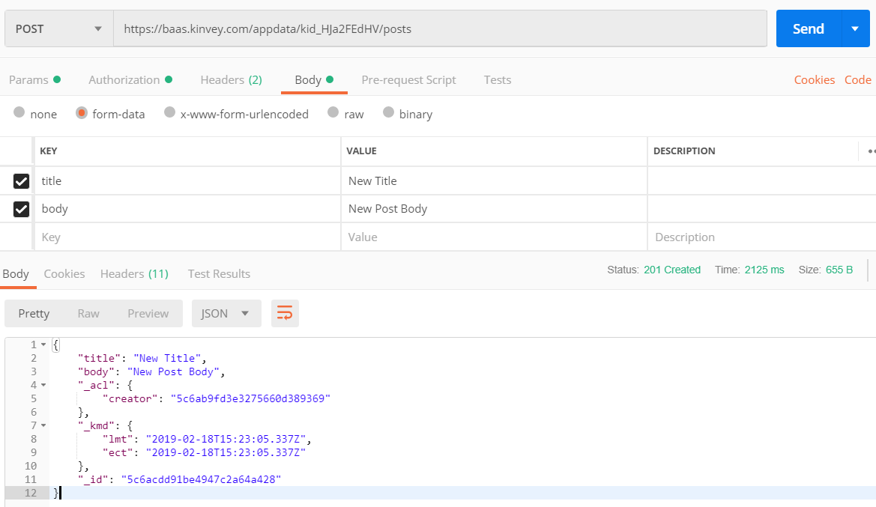
Kinvey and Postman: Create a New Post
URL: https://baas.kinvey.com/appdata/{app_id}/posts
Method: POST
Authentication: Basic
User / pass: guest / guest
Request body
title: New Title
body: New Post Body

Slide 20
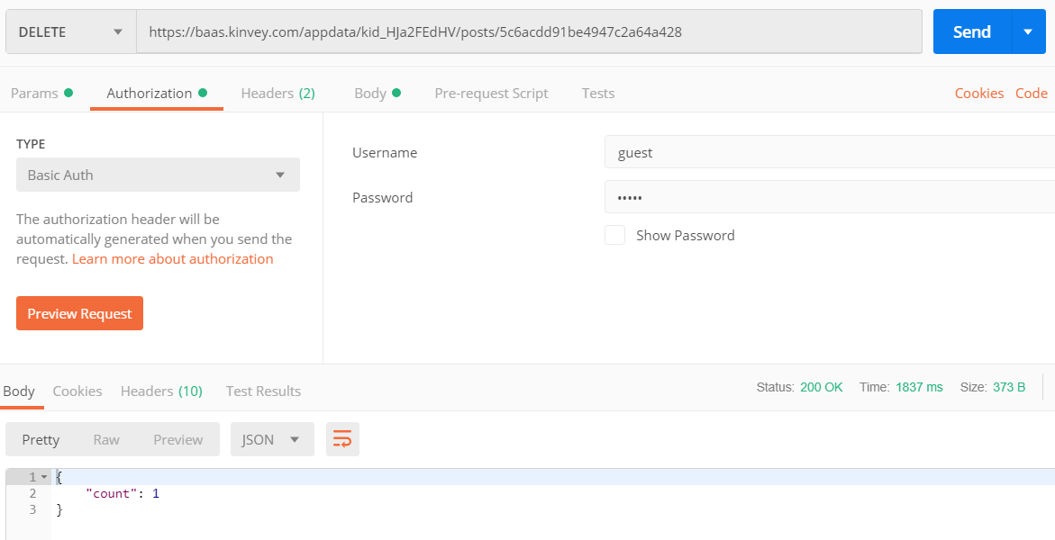
Kinvey and Postman: Delete an Existing Post
URL: https://baas.kinvey.com/appdata/{app_id}/posts/id
Choose an existing post's ID
Method: DELETE
Authentication: Basic
User / pass: guest / guest
Body: (empty)

Slide 21
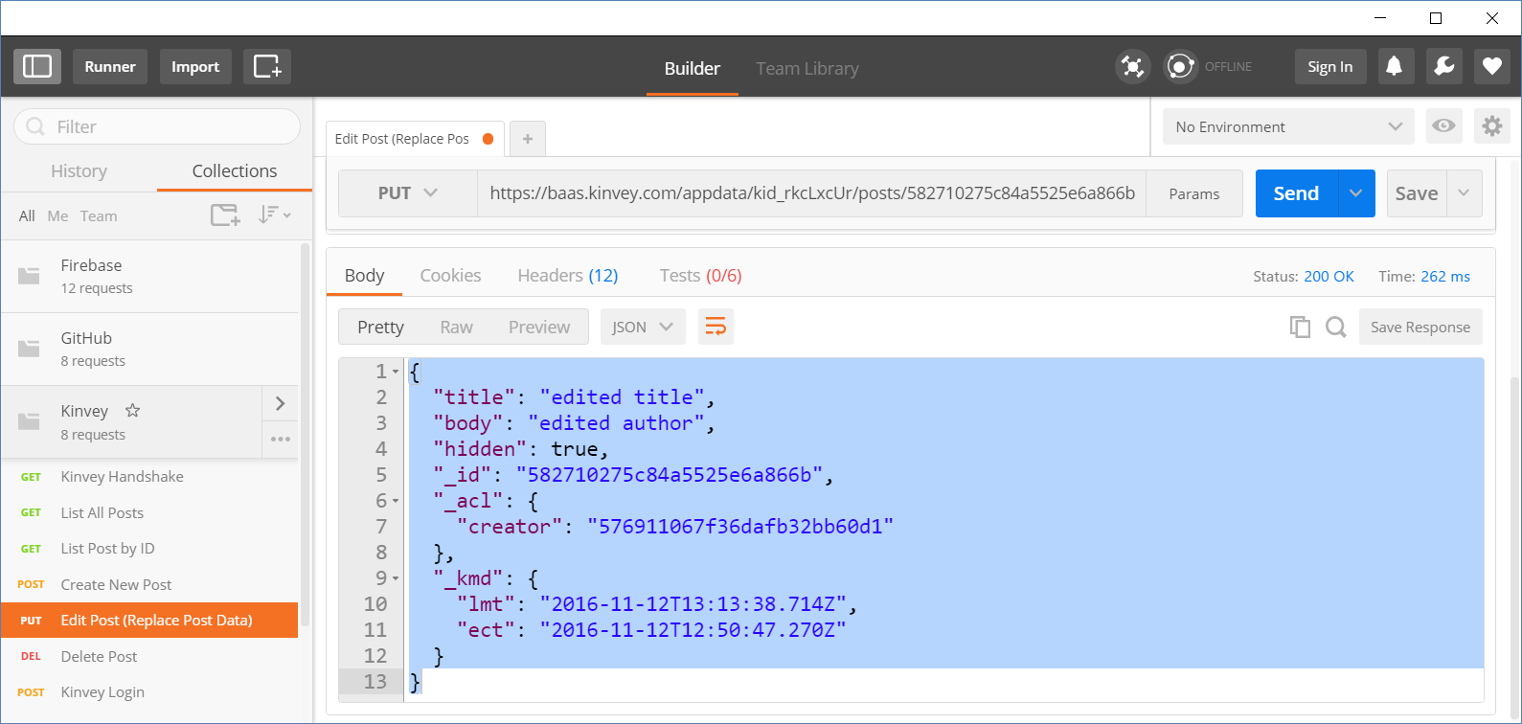
Kinvey and Postman: Edit an Existing Post
URL: https://baas.kinvey.com/appdata/{app_id}/posts/id
Choose an existing post's ID
Method: PUT
Authentication: Basic
User / pass: guest / guest
Body (JSON):
{"title":"edited title", "body":"edited author", "hidden":true}

Slide 22
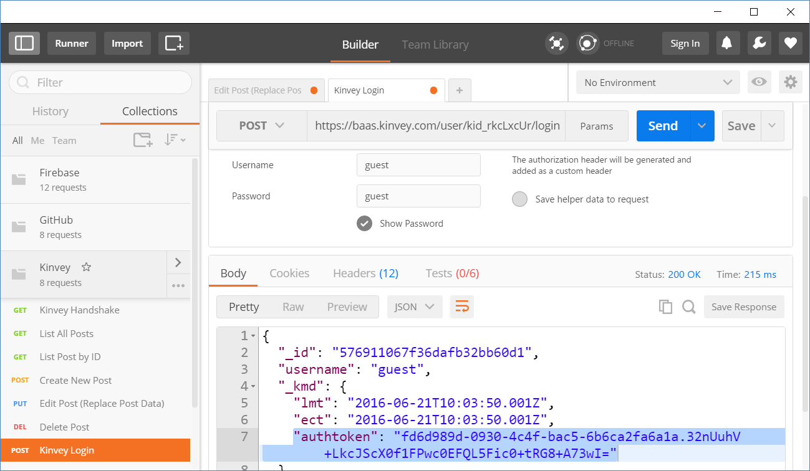
Kinvey and Postman: Login
URL: https://baas.kinvey.com/user/{app_id}/login
Method: POST
Authentication: Basic
User/pass: app_id : app_secret
Body:
Returns: authtoken
{"username":"…", "password":"…"}
"authtoken": "fd6d989d-0930-4c…wI="

Slide 23
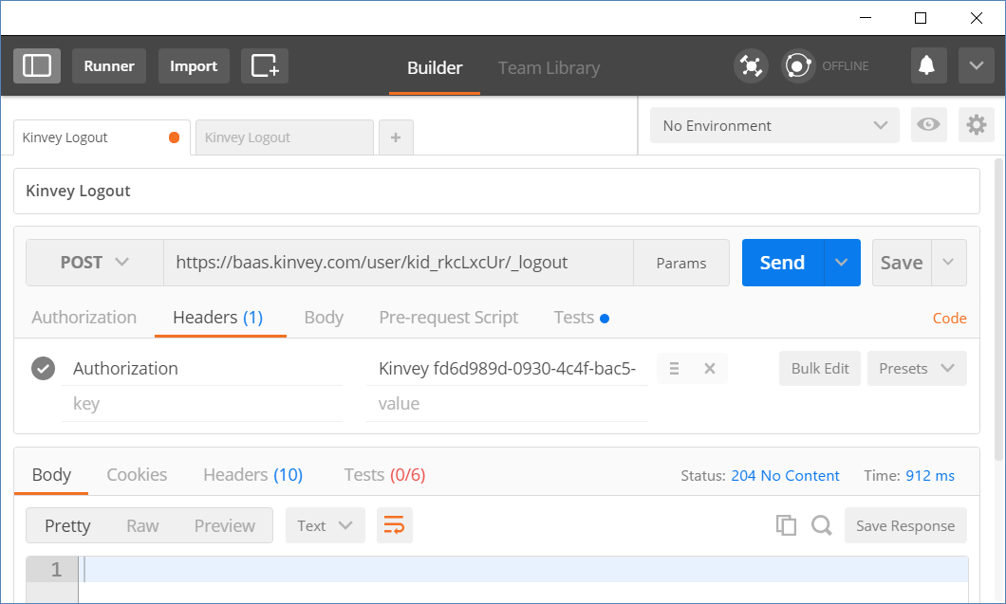
Kinvey and Postman: Logout
URL: https://baas.kinvey.com/user/{app_id}/_logout
Method: POST
Authorization:
Kinvey <authtoken>
Use the token given by the login request
Returns 204 No Content
Authorization:
Kinvey <authtoken>

Slide 24

Live Exercises

Slide 25
Summary
…
…
…
Firebase is JSON-based cloud database
(mBaaS) with REST API
Kinvey is collection-based could database (mBaaS)

Slide 26
https://softuni.bg/courses/js-apps

Slide 27












SoftUni Diamond Partners

Slide 28




SoftUni Organizational Partners

Slide 29




Trainings @ Software University (SoftUni)
Software University – High-Quality Education and Employment Opportunities
softuni.bg
Software University Foundation
http://softuni.foundation/
Software University @ Facebook
facebook.com/SoftwareUniversity
Software University Forums
forum.softuni.bg

Slide 30

License
This course (slides, examples, demos, videos, homework, etc.) is licensed under the "Creative Commons Attribution-NonCommercial-ShareAlike 4.0 International" license

